Slide 1
Team 4: Basketball League Manager
Ariq Zaman
Fuming Qiu
Usman Farooqi

Slide 2
Motivation
Tracker for a basketball league manager
Suited for NBA enthusiasts and Basketball fanatics
Consolidate data, make decisions from team to player level

Slide 3
Tech Stack
HTML/Bootstrap
Thymeleaf
Code logic validation/service layer
Spring Web Framework
JDBC Template
MySql

Slide 4
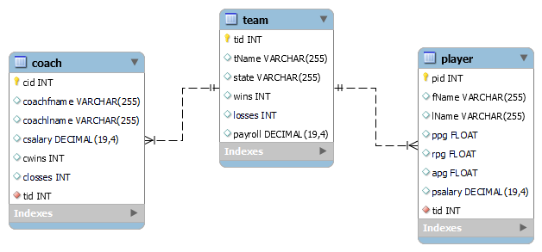
ER Diagram

Slide 5
Live Demo

Slide 6
Lessons Learned
Make front – end decisions early
Better time management
Understand how your framework works
Communication/ Team building

Slide 7
Q & A

